Slide 1
Striving for Work and Overcoming Barriers:
2015 National Employment and
Disability Survey
July 21, 2015

Slide 2
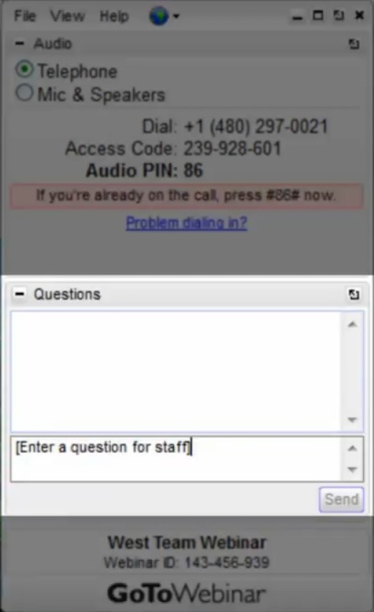
Housekeeping Items
Access the Help Desk: Select the “Help” option in the toolbar at the top of your GoToWebinar navigation panel.
Ask a Question of the Presenters: Click the “Questions” box to type a question for the presenters.
Exit the Webinar: Click the gray “X” in upper right corner of the gray webinar navigation bar.
For Telephone Participants: If you are using the telephone to listen to the webinar, please make sure to use a landline to ensure call clarity.
Webinar Recording: A recording of this webinar will be made available shortly after the webinar’s conclusion.

Slide 3
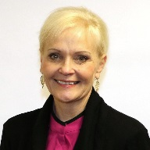
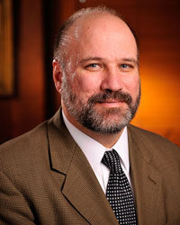
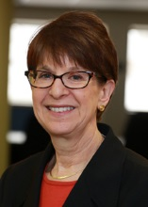
Meet Your Panelists
Moderator:
Stephanie Powers
Senior Director for Policy & Partnerships
Council on Foundations
Andrew J. Houtenville, Ph.D.
Associate Professor of Economics and Research Director of the Institute on Disability
University of New Hampshire
Elaine E. Katz, MS, CCC-SP
Senior Vice President of Grants and Communications
Kessler Foundation
John O’Neill, Ph.D.
Director of Employment and Disability Research
Kessler Foundation

Slide 4
Percent with a Disability in US
Demographic category | Pct.
Total | 19%
Gender
- Women | 20%
- Men | 17%
Race/Ethnicity
- White alone, non-Hispanic | 20%
- Black alone, non-Hispanic | 21%
- Asian alone, non-Hispanic | 13%
- Hispanic | 13%

Slide 5
Percent with a Disability in US
Demographic category | Pct.
Age group | 19%
- Under 15 | 8%
- 15 to 24 | 10%
- 25 to 44 | 11%
- 45 to 54 | 20%
- 55 to 64 | 29%
- 65 to 69 | 35%
- 70 to 74 | 43%
- 75 to 79 | 54%
- 85 and over | 71%

Slide 6
Poverty rates, by disability stats
Age group | Disability | No Disability
Ages 15 to 64 | 25% | 14%
Ages 65 and over | 10% | 5%

Slide 7
Share of population in poverty (25-64)

Slide 8
Share of population in poverty (65+)

Slide 9
Percent Employed, by Disability Status
(Ages 21-64)

Slide 10
Median Annual Wages/Salary
(Ages 21-64)

Slide 11
national Trends in Disability Employments (nTIDE)
The employment-to-population ratio, a key indicator, reflects the percentage of
people who are working relative to the total population (the number of people
working divided by the number of people in the total population multiplied by
100)
In 2014 persons without disabilities (PWoD) experienced an average increase of 1.4% change in the employment-to-population ratio
Whereas, in 2014 persons with disabilities (PWD) experienced an average decrease of 3% in the employment-to-population ratio
However, over the last 8 months the employment-to-population ratio has increased by an average of 10% for PWD and only 1% for PWoD
Caveat …. there remains a current disparity of 43 percentage points in the employment-to-population ratio between those with and without disabilities

Slide 12
Kessler Foundation
2015 National Employment and
Disability Survey
Reframe the discourse:
Informing the design of new interventions and priorities.
Filling information gap:
No nationally representative, credible statistics on the workplace experiences of people with disabilities.
Disparity Striving to Work
Facing Barriers Success in Overcoming Barriers

Slide 13
Sample
Working-age adults with disabilities.
18 to 64 years old.
Screening questions used in past surveys.
American Community Survey (US Census).
A Canadian survey on disability.
People with sensory, physical, mental, and developmental disabilities were interviewed.
Proxies were used with individuals who could not complete the survey themselves.

Slide 14
Methods
Telephone survey of 3,013 people with disabilities nationwide.
MSE for entire survey is +/- 1.8%.
Random Digit Dialing (RDD) Survey.
Randomly selected land lines and cell phones.
Random selection of an adult in household with a disability.
Interviews conducted between October 2014 and April 2015 by UNH Survey Center and Penn State Survey Research Center.

Slide 15
Resulting Sample
19% of all households completing the survey had at least one working-age adult with a disability.
Data weighted to reflect ACS estimates (age, race, sex and region of country) for working-age adults with disabilities.

Slide 16
Striving for Work

Slide 17
Hours Worked
60.7%
40.6%
35.5 hours

Slide 18
Overcoming Barriers in Job Search
 | Faced | Overcome
Not enough education or training……………….. | 41.1 | 38.5
Employers assumed you can't do the job……… | 36.0 | 32.8
Lack of transportation……………………………. | 25.6 | 41.9
Being denied health ins, work-related benefits... | 19.8 | 16.3
Family discouraged you from working…………. | 10.4 | 63.1

Slide 19
Overcoming Barriers at Work
 | Faced | Overcome
Getting less pay than others in a similar job…... | 16.5 | 38.6
Negative attitudes on the part of supervisor…… | 15.7 | 41.3
Negative attitudes on the part of coworkers…… | 15.5 | 54.5
Family members discouraged you……………… | 6.5 | 64.3
Lack of job counseling…………………………… | 5.5 | 33.3

Slide 20
Key Takeaways
Work is very important to many people with disabilities.
They show it in the things they do to search for jobs, prepare for employment, and overcome barriers.
People with disabilities are striving to work:
working,  looking for work, and
preparing for work,  worked post-onset.
Many are successfully overcoming barriers, when they are looking for work and in the workplace.

Slide 21
Putting Faith to Work Model
Training
Technical Assistance
Linkages to Services & Resources
Connections to Other Congregations
Congregation
Members
Community Groups
Businesses & Employer Networks
Other Associa-tions
Civic Groups
Non-Profits
Other Churches Synagogues Mosques
Schools and Colleges
Friends & Relatives
Access to Meaningful Work
For People with Disabilities

Slide 22
KESSLER’s Signature Employment Grant
INTRODUCTION
Business Leadership Network (BLN)
PolicyWorks
KESSLER Foundation Signature Employment Grant
Interwork Institute
C2C-Bridging the Gap
University Partners - UCB/SDSU/CSUF
Department of Rehabilitation (DOR)

Slide 23
PROJECT INNOVATION
College Student
Peer and Career Mentors
Career – Path Employment
Internships
Targeted Skills Curriculum
Bridging to Career-Path Employment
A Non-Traditional Person-Driven Approach

Slide 24
Participant Flow Chart
PROJECT COMPONENTS
Student Recruitment
C2C Professional Development and Disability
Course
Participant meets with Peer Mentor to plan and schedule activities.
Peer and Career Mentorship:
Guidance
Referrals
On-going support
Develop Career Plan
Course Enrollment
Participant matched with Career Mentor. Schedule and plan activities.
Participant works with Placement Specialist to choose internship, work experience and placement opportunities developed by community partners.
Participant applies for internship/Placement
N
NO
YES
Internship/Career Path Employment

Slide 25
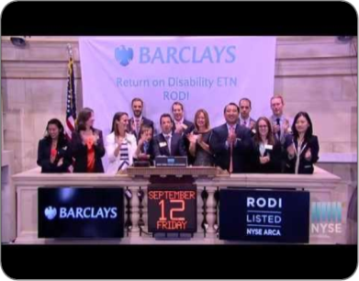
Pepsi ACT Achieving Change Together
Pepsi ACT is a beverages inspired initiative to increase hiring and retention of qualified jobseekers with disabilities.
Compliance
Business Objectives
Value of Diversity
Performance
w/ Purpose
5

Slide 26
Pepsi ACT – Achieving Change Together
Pepsi ACT is a national partnership between PepsiCo and Disability Solutions @Ability Beyond (non-profit consulting partner) that is supported by the funder collaborative.
Currently in the process of launching 10 sites in all 8 PepsiCo regions
Pilot sites located at production and distribution centers, certified center, and call center
Al Carey, CEO - PepsiCo North America Beverages is updated monthly on progress
Proof Point – Retention:
Retention rate for Pepsi ACT employees =74%
Average PepsiCo Frontline Retention Rate = 64%
= Launched Sites
= Upcoming Sites
Burnsville, MN
Houston, TX
Las Vegas, NV
Nashville, TN
Orlando, FL
Phoenix, AZ
Winston-Salem, NC
6

Slide 27
Pepsi ACT: Project Totals
Updated: May 31, 2015
Status | Count
Started Work | 75
Remain Working | 58
Project Retention Rate | 77%
Average Frontline Retention Rate | 64%
Site | Count
Burnsville, MN | 2
Houston, TX | 7
Las Vegas, NV | 18
Winston-Salem, NC | 11
National – Online Portal | 20
Hourly | $ Per Hour
Minimum Starting Wage | $13.50
Max Starting Wage | $24.00
Average Wage | $18.38
8

Slide 28
Q&A

